Slide 1
Internal Sort
Terry Luedtke
DS5012
Fall 2025

Slide 2


Internal Sort on External Data or, The more things change, the more they stay the same.

Slide 3


Internal Sort on External Data or, The more things change, the more they stay the same.
Notes:
Images of Bon Jovi and Jean-Baptiste Alphonse Karr from Wikipedia.
Karr is remembered for many of his statements,^{[12]} including the well-known aphorism plus ça change, plus c'est la même chose,^{[13]} usually translated as "the more things change, the more they stay the same".

Slide 4
Internal Sort - Definition
Internal sort is any sorting process that uses only the computer's main memory (RAM) because the dataset is small enough to fit entirely in memory at once.
But…
Programs can access “addressable memory” which is significantly larger than RAM. This is theoretically 16 exabytes for a 64 bit cpu, though some architectures are limited to 48 bits (256 terabytes)
Notes:
Definition: Any sort algorithm which uses exclusively main memory during the sort. This assumes high-speed random access to all memory.
https://xlinux.nist.gov/dads/HTML/internalsort.html

Slide 5
Beyond RAM
Modern OS can use drives to extend memory:
Virtual Ram: memory management technique to use drives to expand physical RAM creating the illusion of large main memory.
Memory Mapped File: Addressable memory assigned directly byte-for-byte to a file. Allows applications to treat the mapped portion as if it were primary memory.
Notes:
https://en.wikipedia.org/wiki/Virtual_memory
https://en.wikipedia.org/wiki/Memory-mapped_file

Slide 6

HDD vs SDD
https://youtu.be/zOD1umMX2s8

Slide 7
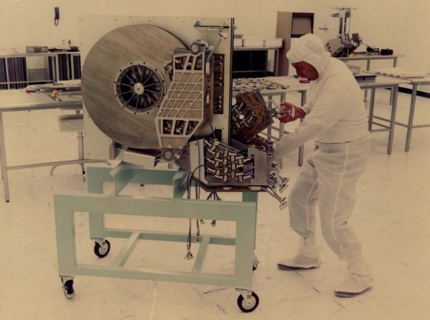
HDD vs SSD
State-of-the-art hard disk drive from the ‘70s
Notes:
https://www.pingdom.com/blog/amazing-facts-and-figures-about-the-evolution-of-hard-disk-drives/
The first HDD^{[11]} had an average seek time of about 600 ms.^{[12]} and by the middle 1970s, HDDs were available with seek times of about 25 ms.^{[13]} Some early PC drives used a stepper motor to move the heads, and as a result had seek times as slow as 80–120 ms, but this was quickly improved by voice coil type actuation in the 1980s, reducing seek times to around 20 ms. Seek time has continued to improve slowly over time.
The fastest high-end server drives of 2010 had a seek time around 4 ms.^{[14]} Some mobile devices have 15 ms drives, with the most common mobile drives at about 12 ms^{[15]} and the most common desktop drives typically being around 9 ms.
Rotational latency (sometimes called rotational delay or just latency) is the delay waiting for the rotation of the disk to bring the required disk sector under the read-write head.^{[22]} Older 3600rpm drives had a latency of 8.33ms though this rpm is only found in very old drives(mid 90s and earlier). It depends on the rotational speed of a disk (or spindle motor), measured in revolutions per minute (RPM).^{[5][23]}
Measurement of seek time is only testing electronic circuits preparing a particular location on the memory in the storage device. Typical SSDs will have a seek time between 0.08 and 0.16 ms.
https://en.wikipedia.org/wiki/Hard_disk_drive_performance_characteristics
Sequential-access performance
Consumer SSDs offer transfer rates between 200 MB/s and 14800 MB/s, depending on the model.^{[31]}
HDDs transfer data at approximately 200 MB/s, depending on the rotational speed and location of data on the disk. Outer tracks allow faster transfer rates.^{[32]}
Random-access performance
SSD random access times typically range from 0.05-0.2 ms (50-200 microseconds) for consumer NAND SSDs, with NVMe drives achieving 0.05-0.1 ms and SATA SSDs around 0.5-0.6 ms.^{[33]}
HDD random access times range from 2.9 ms (high-end) to 12 ms (laptop HDDs).^{[34]}
https://en.wikipedia.org/wiki/Solid-state_drive
By the late 1980s, drives with an ST-412 interface were capable of average seek times between 15 and 30 milliseconds.
https://en.wikipedia.org/wiki/ST-506/ST-412
SSDs are faster than HDDs: SSDs offer substantial improvements in data transfer over HDDs. The fastest commercially available HDDs offer speeds of 160MB/s, while even an entry-level SSD will typically be over 3 times faster, with many SATA drives easily delivering over 500MB/s read and write speeds. Top-performing NVMe drives on the market can reach speeds up to 7,000MB/s, perfect for transferring large files such as videos or large graphic files.
https://www.kingston.com/en/blog/pc-performance/hdd-vs-external-ssd
The absolute fastest HDDs can supposedly hit 480 MBps read speeds, but these are expensive enterprise drives, and most consumer-grade models are likely to top out at around 160 MBps.
By contrast, there are plenty of entry-level SSDs that will break 500 MBps in both read and write speed, and even these are embarrassed by the fastest models. The Samsung 980 Pro, for instance, is rated at 7,000 MBps for reads and 5,000 MBps for writes.
It’s important to note that speeds are heavily reliant on the interface that the drive uses to connect to your system. The SATA interface, used by HDDs and cheaper SSDs, is the slowest. The PCIe 3.0 requires pricier NVMe (Non-Volatile Memory) SSDs, but can go a lot faster, up to around 3,500 MBps. The most recent (and expensive) interface to consider is PCIe 4.0, which unlocks the kinds of speeds you’d see from the Samsung 980 Pro.
https://www.tomsguide.com/reference/ssd-vs-hdd-which-is-best-and-how-are-they-different

Slide 8
Virtual Memory Sort
def virtual_sort(name, n):
data = np.ndarray(n, dtype='float64')
rng = np.random.default_rng(seed)
data[:] = rng.uniform(low=0.0, high=2**64+0.1, size=n)
start_perf_counter = time.perf_counter()
data.sort(kind='quicksort')
end_perf_counter = time.perf_counter()
elapsed_perf_counter = end_perf_counter - start_perf_counter
return elapsed_perf_counter

Slide 9
Memory Mapped Sort
def mapped_sort(name, n, dir):
filename = f'{dir}data{name}.dat'
data = np.memmap(filename, dtype='float64', mode='w+', shape=(n,))
rng = np.random.default_rng(seed)
data[:] = rng.uniform(low=0.0, high=2**64+0.1, size=n)
data.flush(); del data
data = np.memmap(filename, dtype='float64', mode='r+', shape=(n,))
start_perf_counter = time.perf_counter()
data.sort(kind='quicksort')
end_perf_counter = time.perf_counter()
elapsed_perf_counter = end_perf_counter - start_perf_counter
return elapsed_perf_counter

Slide 10
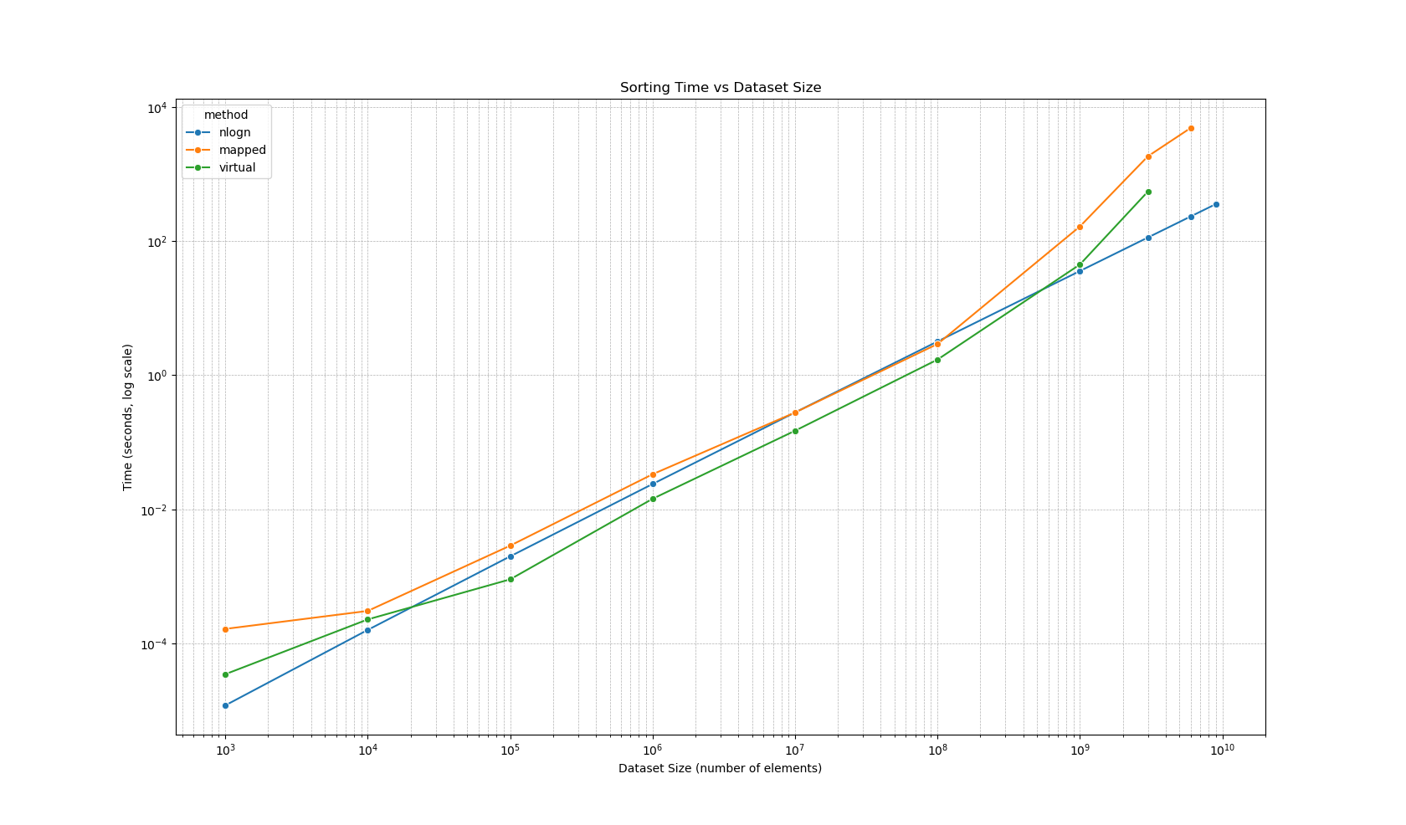
Sorting Times

Slide 11
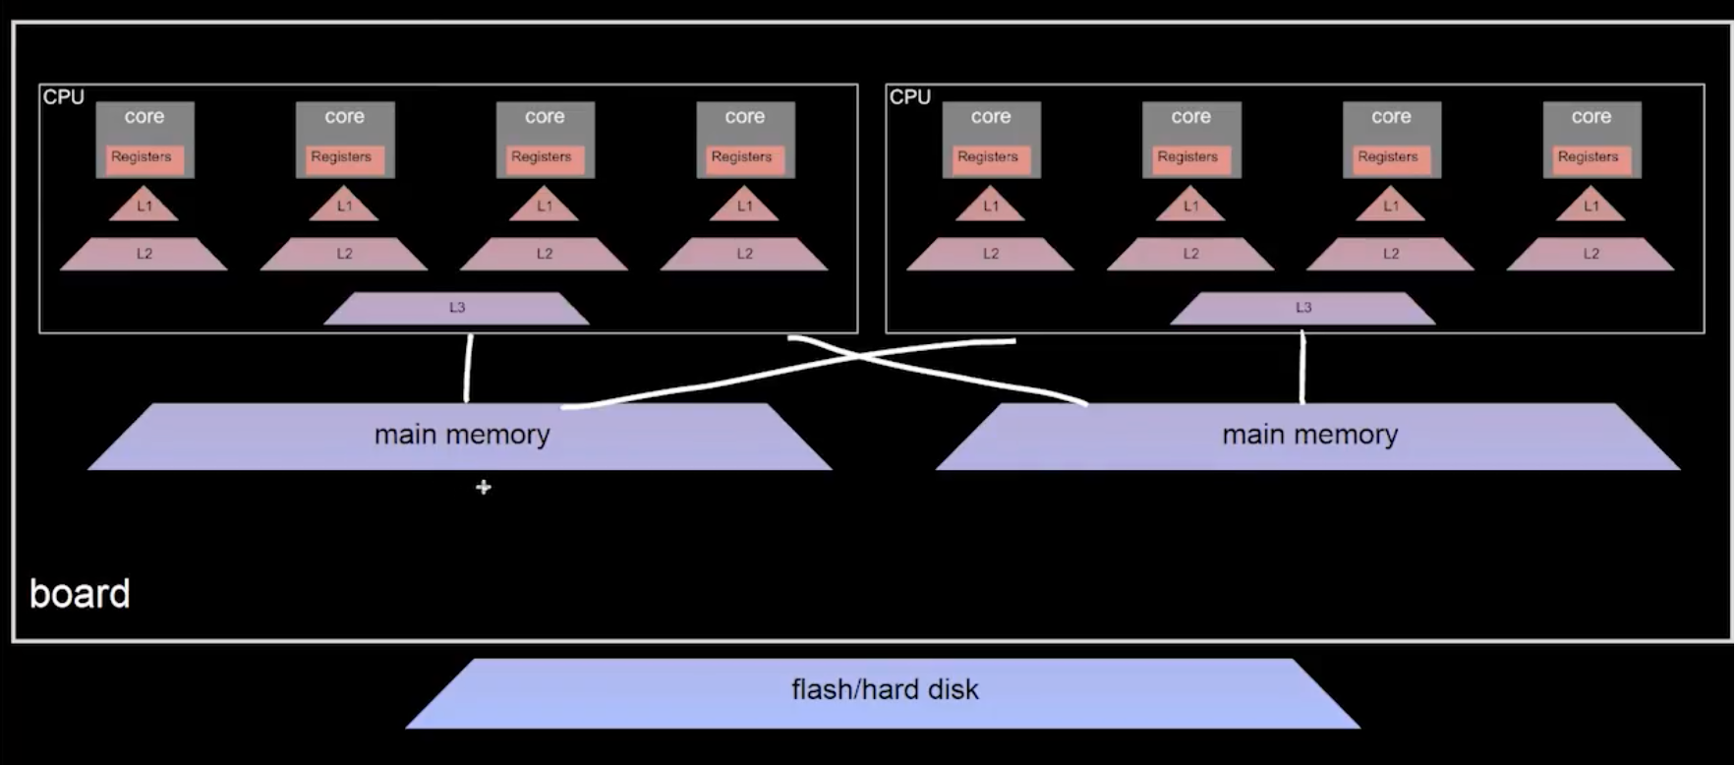
The more they stay the same
Image from “Multicore Storage Hierarchies, NUMA”, Dr. Jens Dittrich. https://www.youtube.com/watch?v=UzQOv4ibX5U
Notes:
Local-memory latency is currently at around 90-100ns, while remote memory has a latency of 150-300 ns
https://osg.tuhh.de/Lehre/V_MSC/03-vm-numa.html
https://en.wikipedia.org/wiki/Cache_hierarchy

Slide 12

Other Interesting Optimizations
https://www.youtube.com/watch?v=c33AZBnRHks

